Slide 1
Intermediate Algebra
Clark/Anfinson

Slide 2
Chapter 4
Quadratic Functions

Slide 3
Chapter 4 - section 4
Solving using roots

Slide 4
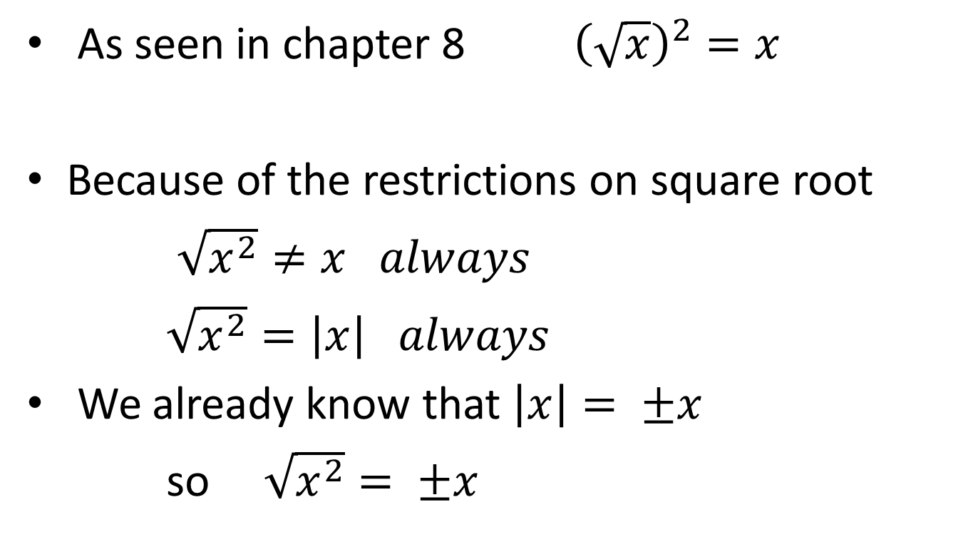
Quirk of square roots
As seen in chapter 8 ${\left(\sqrt{x}\right)}^{2}=x$
Because of the restrictions on square root
$\sqrt{x^{2}}≠x always$
$\sqrt{x^{2}}=\left|x\right| always$
We already know that $\left|x\right|= ±x$
so $\sqrt{x^{2}}= ±x$

Slide 5
Solve using inversing
x² = 16
x² = 15
x² = -36

Slide 6

More examples
(x + 5)² – 9 = 12
- 5(x – 3)² + 12 = -13
4(2 – 3x)² + 17 = -3
$\sqrt{x^{2}+16}=7$

Slide 7
Chapter 4- section 5
Solving by factoring

Slide 8
When square root doesn’t work
Given x² – 4x = 12
For many polynomials of this type you can split the problem using a simple rule called the zero product rule
Rule ab = 0 if and only if a = 0 or b =0
Key elements – one side of equation is zero
the other side is FACTORS

Slide 9
Zero product rule: examples
(x – 9)(3x + 5) = 0
x(x – 12) = 0
x² – 15x + 26 = 0
x³ – 7x² – 9x + 63 = 0
2x² + 7x + 3 = 0

Slide 10
More Examples
x² – 4x = 12
(x – 2)(x + 5) = 18

Slide 11
Chapter 4 – section 5b
Completing the square

Slide 12
Solving quadratics
Isolate the x - use square root - works when the x only appears once in problem
Factoring – separates the x – works when the polynomial will factor
Completing the square is a “bridge” that allows you to solve ALL quadratics by square root

Slide 13
Creating Square trinomials
(x + h)² = x² + 2hx + h² no matter what h =
(x + ___)² = x² + 8x +_____
(x + ___)² = x² + 20x + ______
NOTE – square trinomials can be written with one x!!!!!

Slide 14
Completing the square to solve
x² + 8x +13 = 0
x² + 20x – 7 = 0

Slide 15
More complicated examples
3x² – 6x + 12 = 0
7x² – 11x + 12 = 0

Slide 16
Chapter 4 – section 6
Quadratic formula

Slide 17
Deriving the quadratic formula Solve ax² + bx + c = 0 by completing the square
Divide by a :
Move constant to the right
Divide middle coefficient by 2 /square/ add
Get a common denominator and combine fraction
Write as a square
Isolate the x

Slide 18
Using a formula
Identify the necessary values
Replace variables with values
Simplify following order of operations

Slide 19
Using quadratic formula
Equation MUST be simplified, equal to zero, in descending order
3x² – 2.6 x - 4.8 = 0
a = ? b = ? c = ?
so

Slide 20

Estimating values
3x² – 2.6 x + 4.8 = 0
x = $\frac{−(−2.6)±\sqrt{{(2.6)}^{2}−4(3)(4.8)}}{2(3)}$
x =

Slide 21
More examples

Slide 22
Chapter 4 section 1
Parabolas

Slide 23
Quadratic equations
Quadratic equations are polynomial equations of degree 2.
All quadratics graph a similar pattern – like all linear equations graph a straight line
The pattern for a quadratic is called a parabola

Slide 24
Determine the pattern for each function
Decide whether the equation is linear, quadratic or neither.
3x – 7y = 12
5x² – 2x = y
(x + 7)(x – 9) = y
(5 – 3x – 7x²)²= y
$\frac{1}{x^{2}}−2x^{2}=y$

Slide 25
Characteristics of a parabola
A parabola looks like a valley or a mountain
A parabola is symmetric
the domain is NOT restricted – but is often spoken of as 2 intervals- increasing and decreasing intervals
A parabola has either a maximum (mountain) or a minimum (valley) point – thus the range is restricted
A parabola has exactly one y – intercept
A parabola has AT MOST 2 x – intercepts but may have only one or none at all

Slide 26
Graphically
Line of symmetry
y
Orientation up (or down)
increasing
Decreasing
Y-intercept
x
X-intercept
X-intercept
Vertex- Minimum (or maximum if oriented down

Slide 27
Use the graph to answer questions
Find the vertex – state the range
find the y- intercept
Find the x – intercept
Find the line of symmetry
Find f(2)
Find where f(x) = -10

Slide 28
Use the graph to answer questions
Find the vertex
find the y- intercept
Find the x – intercept
Find the line of symmetry
Find f(-5)
Find where f(x) = 7
On what interval is f(x) increasing?
On what interval is f(x) decreasing?

Slide 29
Use the graph to answer questions
Find the minimum point
Find the maximum point
What is the range?
Find the x – intercept
What is the domain
Find f(9)
Find where f(x) = 6
On what interval is f(x) increasing?
On what interval is f(x) decreasing?

Slide 30
Using symmetry to find a point
if f(x) has a vertex of (2,5) and (5,8) is a point on the parabola find one other point on the parabola.

Slide 31
Chapter 4 – section 2
Vertex form

Slide 32
Forms of quadratic equations
Standard form
f(x) = ax² + bx +c = y
Vertex form – completed square form
f(x) = a(x – h)² + k = y
Factored form
f(x)= (x – x₁)(x – x₂) = y

Slide 33
What we want to know
Y-intercept - find f(0)
X-intercept - solve f(x) = 0
Vertex - orientation – maximum, minimum- line of symmetry – range
rate of increase or decrease

Slide 34
Vertex form = what the numbers tell you
given f(x) = a( x – h)² + k where a, h and k are known numbers
a is multiplying - scale factor – acts similarly to m in linear equation
a>0 - parabola is oriented up
(valley - has a minimum)
a < 0 – parabola is oriented down
(mountain – has a maximum)
as a increases the Parabola gets “steeper” - looks narrower
f(h) = k so (h,k) is a point on the graph in fact -
(h, k) is the vertex of the graph – so the parabola is h units right(pos) or left(neg) and k units up(pos) or down(neg)

Slide 35
Examples
f(x) = 3(x + 4)² + 5
a = 3 parabola is a valley –
parabola is narrow
(h , k ) = (-4, 5) parabola is left 4 and up 5
Specific information f(0) =
f(x) = 0 (not asked in webassign)
line of symmetry - x =
range domain
using symmetry to find a point f(-1) = what?
what other point is on the parabola due to symmetry

Slide 36
Example
g(x) = .25x² – 7 [seen as vertex form - g(x) = .25(x – 0)² – 7]
a = h = k =
g(0) = g(x) = 0
Line of symmetry domain range
Is (4, -3) on the graph? What other point is found using symmetry?

Slide 37
Example
h(x) = -(x – 3)² + 5
a = h = k =
h(0) h(x) = 0
Line of symmetry domain range

Slide 38
Example
k(x) = -3(x – 8)²
a = h = k =
k(0) = k(x) =
Line of symmetry range domain

Slide 39
Chapter 4 – section 7
Standard form

Slide 40
From standard form- f(x) = ax² + bx + c
a is the same a as in vertex form – still gives the same information b and c are NOT h and k
Find y- intercept - still evaluate f(0)
x – intercept - still solve f(x) = 0
What the quadratic formula tells us about vertex -
vertex is ( -b/2a, f(-b/2a))

Slide 41
Example
f(x) = x² – 8x + 15
a = 1 means ???
f(0) = f(x) = 0
vertex is :

Slide 42
example
g(x) = - 2x² + 8x - 24
a = g(0) = g(x) = 0
Find vertex:
line of symmetry range domain etc.

Slide 43
Example
j(x) = 3x² - 9 [seen as standard form b = 0]
a = j(0) = j(x) = 0
Vertex =

Slide 44
Chapter 4 – section 3(replaced)
Finding models

Slide 45
Given vertex and one point
If vertex is given you know that
f(x) = a(x – h)² + k
so the only question left is finding a
Example vertex (3, 8) going through (2,5)
f(x) = a(x -3)² + 8
and f(2) = a(2 – 3)² +8 = 5
so a + 8 = 5 and a = -3
thus f(x) = -3(x – 3)² + 8

Slide 46
Examples
Vertex (-2,-3) y – intercept (0, 10)
Vertex (5,-9) point (3,12)

Slide 47
Given x-intercepts and a point
intercepts are solutions that come from factors
(x₁,0) implies x = x₁
came from x – x₁ = 0
so (x – x₁) is a factor
Example: (3, 0) and (5,0) (0, 30)
thus (x – 3) and (x – 5) are factors
and f(x) = a(x – 3)(x – 5)
Again – find a f(0) = a(-3)(-5) = 30
15a = 30
a = 2
so f(x) = 2(x – 3)(x – 5)

Slide 48
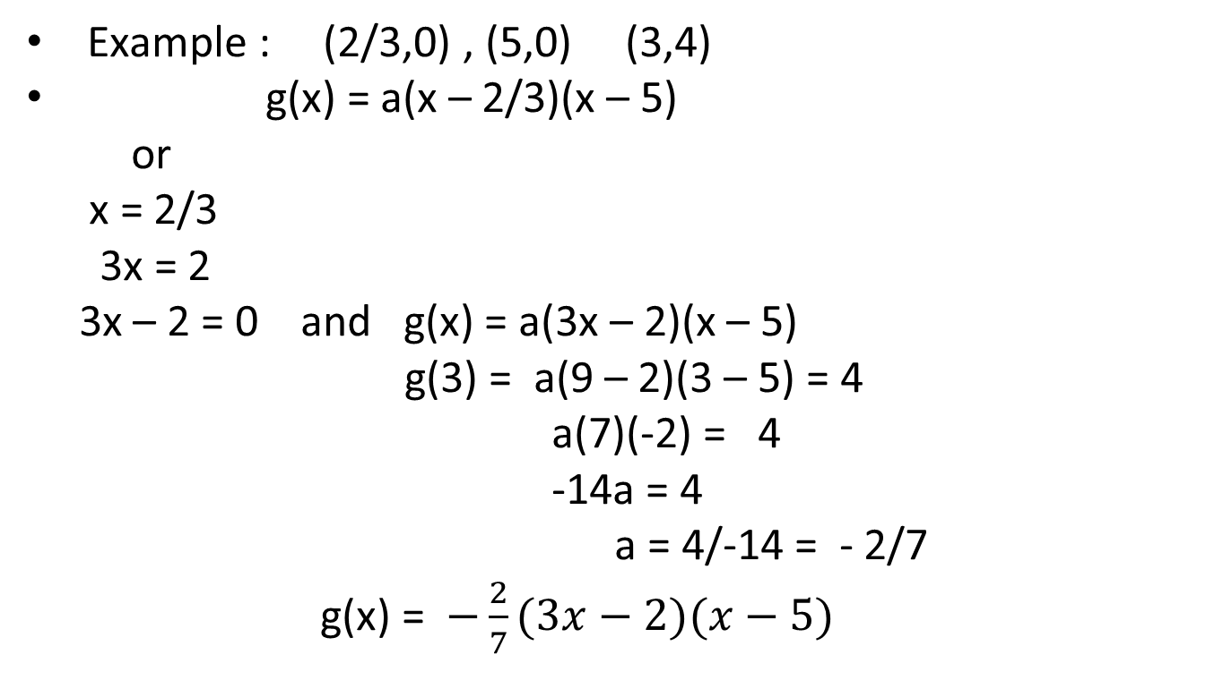
Given x-intercepts and 1 point
Example : (2/3,0) , (5,0) (3,4)
g(x) = a(x – 2/3)(x – 5)
or
x = 2/3
3x = 2
3x – 2 = 0 and g(x) = a(3x – 2)(x – 5)
g(3) = a(9 – 2)(3 – 5) = 4
a(7)(-2) = 4
-14a = 4
a = 4/-14 = - 2/7
g(x) = $−\frac{2}{7}(3x−2)(x−5)$

Slide 49
Note – given 3 random points
The equation for a parabola can be found from any 3 points - we do not have the skills needed to do this - shades of things to come

